Slide 1



Distributed Systems and Internet technologies
PERSISTENCE
Juan Luis Gorricho

Slide 2
PERSISTENCE
There are three persistence mechanisms:
  Preferences
  Files:
    Internal files (phone memory)
    External files (external memory)
  Data bases
The information is not shared among different apps, except for external files.
2

Slide 3
PREFERENCES
Tool to save pairs of key-value using native Java types for the values.
Preferences with Application scope: getSharedPreferences(fileName,mode); saved at:
/data/data/package_name/shared_prefs
Preferences with Activity scope: getPreferences(mode); it takes the name of the activity for the saved file.

Slide 4
PREFERENCES
To write or modify a pair key-value you must first retrieve an editor: SharedPreferences.Editor
To read a preference use the get() method.

Slide 5
INTERNAL FILES
Two operational directories are defined:
  Internal directory: context.getFilesDir();
  Cache directory: context.getCacheDir();
To create a file:
  File file = new File(context.getFilesDir(), filename);
  File file = File.createTempFile(prefix, sufix, context.getCacheDir());
  Alternatively, for the internal directory:
    FileInputStream fis = context.openFileInput(filename);
    FileOutputStream fos = context.openFileOutput(filename);

Slide 6
INTERNAL FILES
Alternative to delete a file from the internal directory:
  context.deleteFile(fileName);
The internal files are stored in the internal memory of the cell-phone at:
  /data/data/package_name/files
  /data/data/package_name/cache

Slide 7
EXTERNAL FILES
To check if the external memory is available:
String state = Environment.getExternalStorageState();
if (Environment.MEDIA_MOUNTED.equals(state)) { Okay! }
Two categories of files (but all are public) are defined:
  Public files, are not deleted when uninstalling the app.
  Private files, are deleted when the app is uninstalled.

Slide 8
EXTERNAL FILES
To work with the two types of files make use of the directories:
Environment.getExternalStoragePublicDirectory(Environment.DIRECT ORY_PICTURES);
context.getExternalFilesDir(null);
The file access is conventional Java coding:
File file = new File(dir, filename);
The private files are saved at:
/mnt/sdcard/Android/data/package_name/files

Slide 9
EXTERNAL FILES
It is recommended to use the subdirectories predefined by Environment.
To check the available space at the external memory: dir.getFreeSpace() and the total space: dir.getTotalSpace()

Slide 10
PERSISTENCE
Read only files from "resources":
  InputStream is = resources.openRawResource(R.raw.mydatafile); located at res/raw/mydatafile
  InputStream is = context.getAssets().open(filename); located at Assets
Data bases:
  Android supports SQLite
  The SQLiteDatabase class implements the ddbb access logic.

Slide 11
EXERCISE
Review the programming of the methods contained in the GlobalState java class using the "internal files" option to implement the persistence.
Modify the MessagesActivity to locally store the downloaded messages; and to only request for new messages from the remote server.

Slide 12
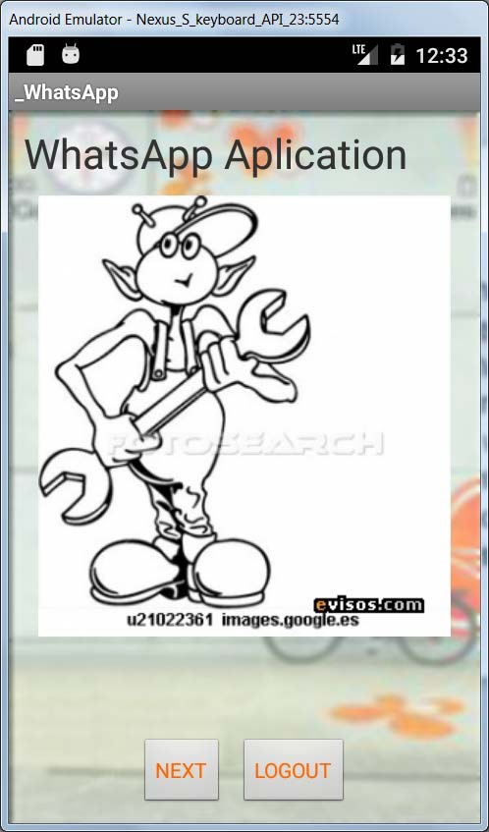
EXERCISE
Modify the WelcomeActivity to use the two buttons in a different way if a user identity is stored locally, so you will show this view instead:

